Slide 1

Wheather App
Front-End Batch
Under The Guidance:
Miss Jayasuruthy L
Name: Pratim Sharma

Slide 2
introduction
I have Created this Weather App using React JS. and OpenWeather Map API.
It’s Shows Weather at any location which You want.

Slide 3
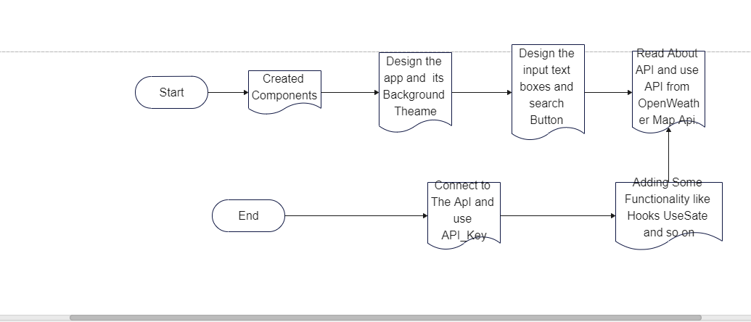
FlowChart

Slide 4
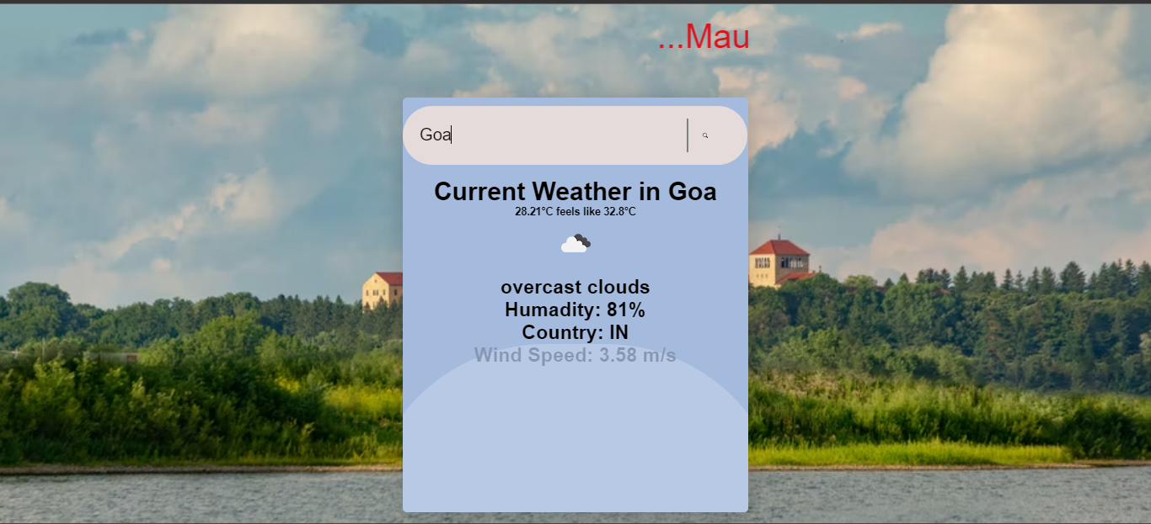
OutPUt

